Slide 1
RESTAURANT BEST LOCATION ANALYSIS
CAPSTONE PROJECT ASSIGNMENT 2020

Slide 2
PROBLEM DESCRIPTION
A global restaurant chain company wants to start a restaurant shop in one of the best neighbourhoods in Toronto city. They want to find the best neighbourhood locations where there are no, or minimal restaurants currently exists in the area. They are looking for less competitors in the area but a more popular place to start with.
Since they are a multicuisine restaurant chains, they want to take into account all types of restaurants that provide different country dishes.
The problem is to find and filter such locations and apply the best statistical approaches to find the best location(s) and visualize with statistical proofs to confirm the analysis.

Slide 3
DATA DESCRIPTION
DATA DESCRIPTION
The primary data that will be needed is the popular locations within Toronto city and a reliable source of data.
We have the Canadian postal data from the wiki which we can leverage to find the popular boroughs and the neighbourhoods that exists in each borough.
https://en.wikipedia.org/wiki/List_of_postal_codes_of_Canada:_M
The data primarily consists of the below details in tabular format
Postal Code
Borough Name
Neighbourhood(s)

Slide 4
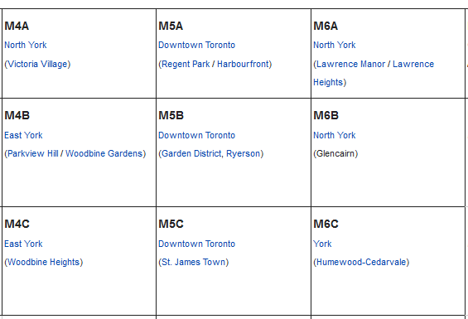
DATA SAMPLE

Slide 5
SOLUTION APPROACH
The existing data is tabular format which we cannot input directly to any data analysis tools. Below is a step by step solution approach to leverage the table data to find suitable locations.
Scrap the Canada Postal data from the web page into processable input format
Get the location data for each neighbourhood/borough and update the input data
Visualize the neighbourhoods in Canada
Get the popular neighbourhoods within a defined geographic circle of Toronto
Explore the neighbourhoods in Toronto
Analyse each neighbourhood based on restaurant data
Cluster each neighbourhood based on restaurant data
Examine and selected the best clusters with that satisfies the restaurant location requirements

Slide 6
DETAILED SOLUTION APPROACH
1. Scrap the Canada Postal data from the web page into processable input format
The webpage data in the tabular form needs to be read and converted into a suitable data structure that can be used as an input to any analysing tools. The web scraping libraries such as Scrapy, beautiful soup or python requests to convert the data into usable format. In this assignment we’ll use the python requests. The expectation is to create a new tabular data structure in below format.
Postal Code | Borough | Neighbourhood(s)

Slide 7
DETAILED SOLUTION APPROACH (CONTD..)
Get the location data for each borough and update the input data
The primary data must be updated with additional useful data, such as geographic location data with latitudes and longitudes to get more information about the places. We can leverage geopy library or third-party data sets to do this. In this assignment we’ll use one of the third-party data sets to combine the location data to the input data set of the Canadian neighbourhoods.

Slide 8
DETAILED SOLUTION APPROACH (CONTD..)
Postal Code | Borough | Neighbourhood(s) | Latitude | Longitude
Visualize the Canadian neighbourhoods
This is an optional step. However, it is useful to get a good high-level visual view of the initial input data set that is going to be analysed and refined in the further stages. We can leverage the existing visualization libraries such as Folium to get this view.
Get the popular neighbourhoods within a defined geographic circle

Slide 9
DETAILED SOLUTION APPROACH (CONTD..)
In this step we’ll get the popular neighbourhoods within a more defined geographical circle in and around Toronto. This requires two steps.
First, the above table must be filtered for records of Toronto.
Pass the required input data to a location data API such as the Foursquare API to get more details on the Toronto neighbourhoods which can be input to the next stages in the solution approach.
The results from the location data API such as FourSquare can be used to get a lot of information about the explored locations such as its popularity and the reasons for its popularity. This can be filtered to identify the suitable locations that can be taken as candidates for the problem statement. A sample response data is shown below for another location.

Slide 10
DETAILED SOLUTION APPROACH (CONTD..)
Explore the neighbourhoods in Toronto
The above step 4 will give you the neighbourhood data in Toronto with additional features and
details. This data can be explored to find the suitable locations to identify where all restaurants exists.
Cluster each neighbourhood based on restaurant data
In this step we’ll cluster the results based on the above business criteria and select the best locations for listing in a tabular and visual format.
Examine and selected the best clusters with that satisfies restaurant location requirements.

Slide 11
METHODOLOGY
Technology : Python, Jupyter Notebook, Anaconda/ FourSquare API
Python Libraries : Python requests / Folium/ Geopy
Download and data set and Wrangle it
The address data obtained from the Wiki was scrapped using the Python requests into input data frame format of python.

Slide 12
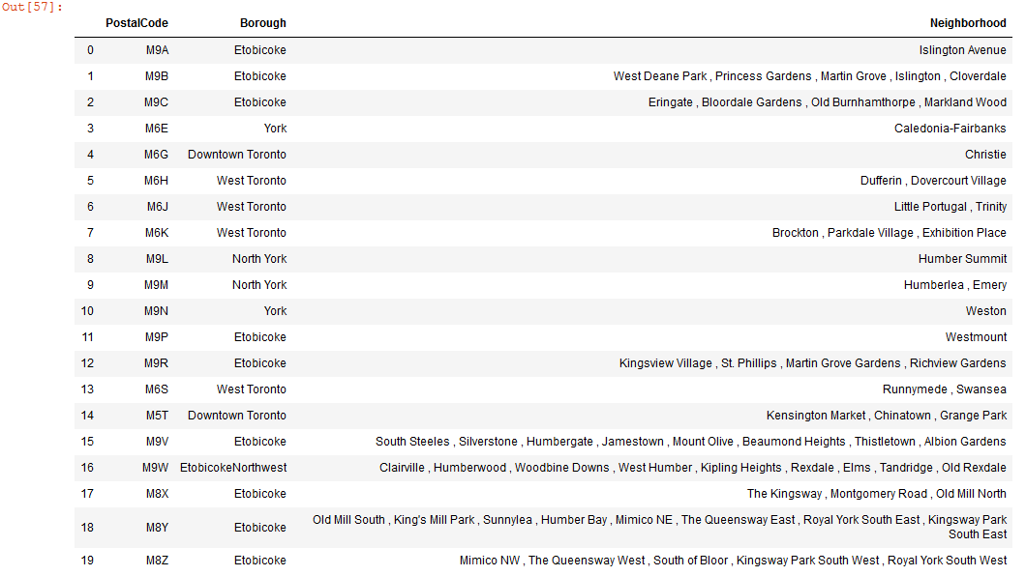
METHODOLOGY

Slide 13
METHODOLOGY (CONTD..)
Filter the data to exclude the areas which does not have a borough. Without a borough we cannot get a more accurate neighbourhood.
Load the external geocode data and then assign it to each matching postal code. Add additional columns latitude and longitude to the postal area data frame.
Filter the Toronto neighbourhoods from the result set.

Slide 14
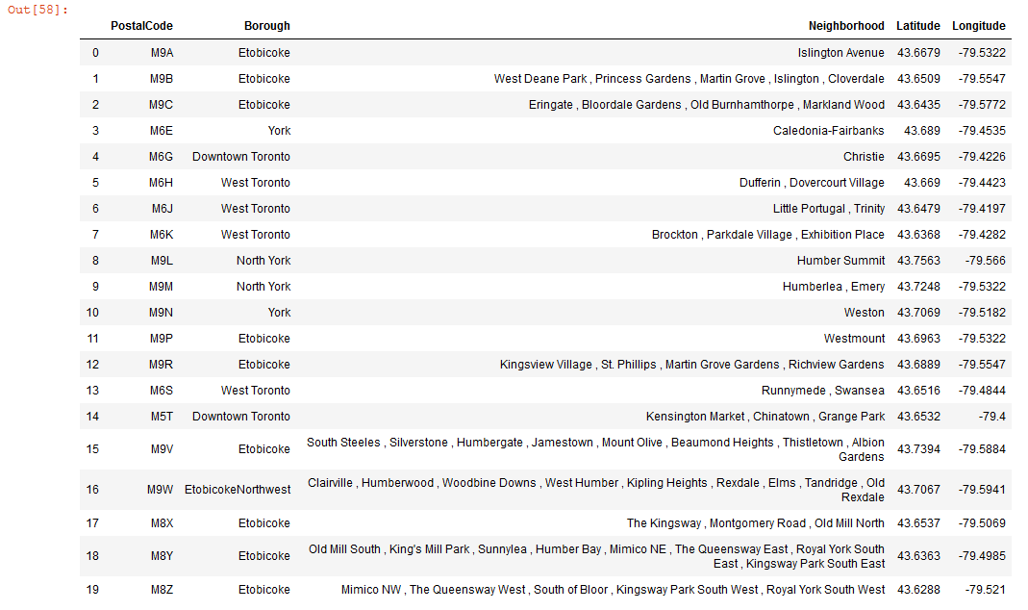
METHODOLOGY (CONTD..)

Slide 15
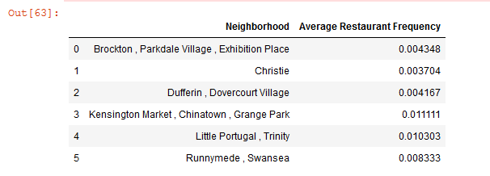
METHODOLOGY (CONTD..)
Explore and Analyse the data set
Looked for the neighbourhoods that show a high mean value for the frequency for the Restaurants and other Diner segments.

Slide 16
METHODOLOGY (CONTD..)
Since there are multiple categories that fall into each Venue, we used the K-Means clustering to group the Neighbourhoods into different clusters.
In this case the number of clusters chosen were 5 and the data was clustered into an increasing order of most common avenues.
Based on the results, the top 5 clusters were chosen to see which clusters had a restaurant in the most common initial venues.
Also, other types of diners were considered to determine the best locations to start a new restaurant.
The mean value for each type of restaurant can be grouped for each Neighbourhood as below.

Slide 17
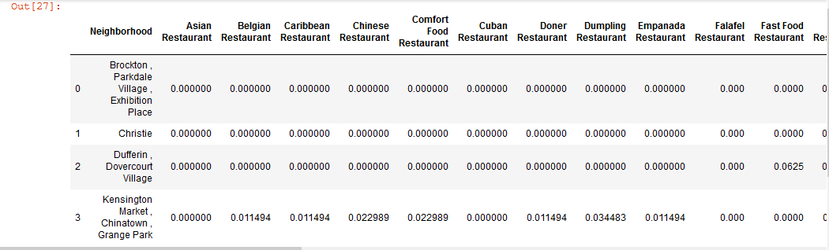
METHODOLOGY (CONTD..)

Slide 18
RESULTS
Based on the analysis, we can see that the below locations have higher mean values for restaurants.
Among these Kensington Market, China Town has a higher mean frequency of restaurants and Christie neighbourhood in Downtown Toronto has a lower value of mean frequency of restaurants.

Slide 19
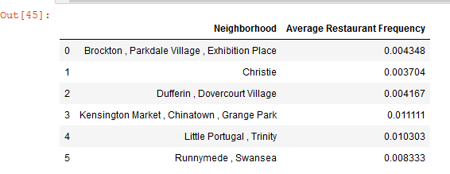
RESULTS

Slide 20
RESULTS
Based on the most common venue ordering also, Christie shows a restaurant in the 10th most common venue only, which makes it a most suitable location for the restaurant company chain to start its first initiative in Toronto.
Also, Christie is the second most popular neighbourhood also.

Slide 21
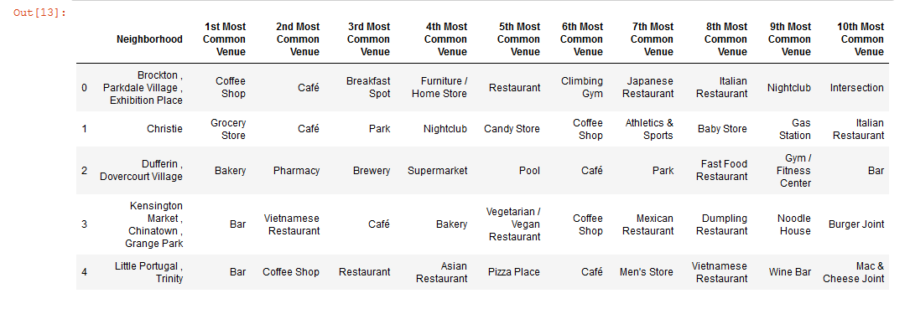
RESULTS (CONTD..)

Slide 22
RESULTS (CONTD..)
The second-best choice would be Dufferin, Dovercourt Village which has the next higher restaurant frequency and has a restaurant as its most common venue in 8th position only.

Slide 23
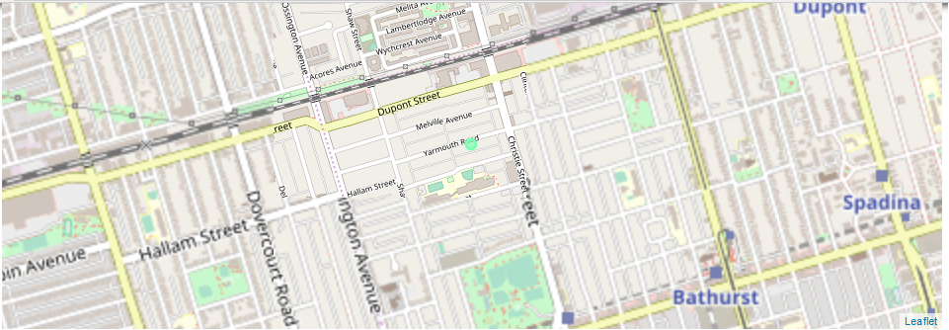
RESULTS (CONTD..)
MAP SHOWING CHRISTIE STREET AS THE BEST LOCATION

Slide 24
DISCUSSION
In addition to above, other types of Diners also can be considered if needed to get a more results on the location. However, it may enlarge the scope of search and reduce accuracy. Also the neighbourhoods available under Toronto is comparatively less. Hence a more rich data set would definitely improve the results.

Slide 25
CONCLUSION
To summarize, the analysis of around 5 neighbourhoods in Toronto revealed two best locations to start a new restaurant with one looks most promising.
The Restaurant location study report can be generalized, expanded and applied to any city around the globe to find solutions to similar problems.

